Slide 1



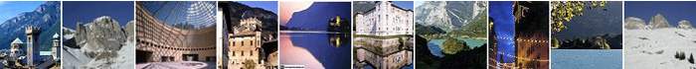
Brain Functional MRI Introduction
Louvain-la-Neuve - Neuroimaging Workshop 2019
Jorge Jovicich
Center for Mind/Brain Sciences (CIMeC),
University of Trento, Rovereto, Italy
CIMeC: https://www.cimec.unitn.it/
MRI Lab: http://r.unitn.it/en/cimec/mri
E-mail: jorge.jovicich@unitn.it

Slide 2
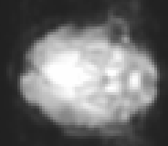
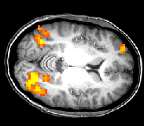
Functional MRI: Why?
Functional images
fMRI signal changes
In area of interest
~2s
Time
Condition
Brain region
of interest
Statistical Map
superimposed on anatomical MRI image
Condition 1
For example:
Condition 1: static dots
Condition 2: moving dots
Condition 2
...
Time
Source: Modified from Jody Culham’s fMRI Newbies web site
~ 5 min
Jorge Jovicich
CIMeC, University of Trento, Italy

Slide 3
Lecture 4 outline
Brain functional MRI:
We want functional contrast:
Blood Oxygenation Level Dependent (BOLD)
We want to measure signal fluctuations
Fast MRI: Echo Planar Imaging
We want “clean” data for modeling & analysis
Pre-processing
Jorge Jovicich
CIMeC, University of Trento, Italy

Slide 4
Brain Functional MRI Contrasts
Options:
Invasive
Vascular volume (gadolinium)
Non-invasive
Blood Oxygenation Level Dependent (BOLD)
Perfusion (CBF: cerebral blood flow)
CMRO2 (Cerebral metabolic rate O2 consumption)
Vascular volume changes (VASO)
… ongoing research (currents, diffusion, etc.)
standard
research
Jorge Jovicich
CIMeC, University of Trento, Italy

Slide 5
Blood Oxygenation Level Dependent (BOLD) contrast
BOLD contrast is the net result of two separate effects:
Hemodynamic response
Magnetic properties of the hemoglobin molecules
Jorge Jovicich
CIMeC, University of Trento, Italy

Slide 6
Energy brain metabolism
Neural function relates to oxygen consumption
Inhaled air
78% nitrogen
21% oxygen
1% inert gases (argon)
0.04% carbon dioxide
Exhaled air
78% nitrogen
16% oxygen
1% inert gases (argon)
4% carbon dioxide
Water vapour
What happened?
C_6 H_12 O_6 + 6O_2
→ 6CO_2 + 6H_2 O + Energy released Glucose + Oxygen
→ Carbon dioxide + water + Energy
Oxygen oxydized glucose to produce energy
Jorge Jovicich
CIMeC, University of Trento, Italy

Slide 7

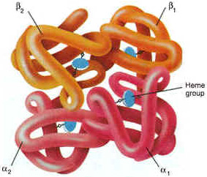
Energy taxi: hemoglobin (Hb)
Each red blood cell: about 250 million Hb molecules
Function: transport of ‘goods’ and ‘wastes’
carries O₂ to tissue and CO₂ away from tissue
one Hb molecule can carry up to 4 atoms of O₂
Hemoglobin molecule structure:
four protein globin chains
each globin chain contains a heme group
at center of each heme group is an iron atom (Fe)
each heme group can attach an oxygen atom (O₂)
Hemoglobin molecule states
Oxy-hemoglogbin
Deoxy-hemoglobin
Source: http://wsrv.clas.virginia.edu/~rjh9u/hemoglob.html,
Jorge Jovicich
CIMeC, University of Trento, Italy

Slide 8
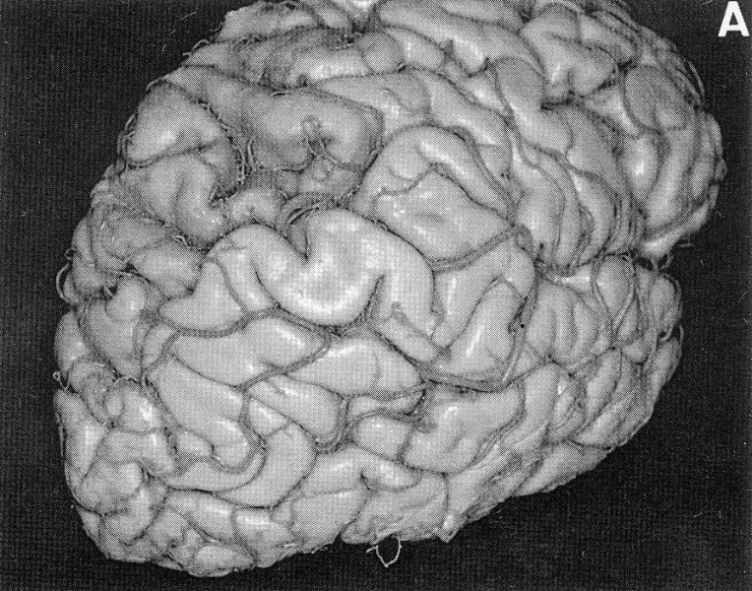
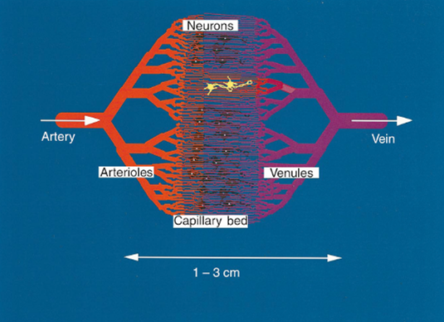
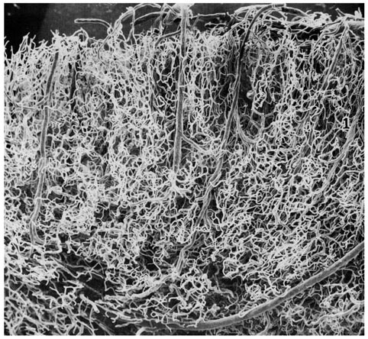
Brain vasculature & hemodynamic response
Brain weight: 2% of body weight
Brain energy budget: ~20% of body
Very efficient irrigation system
Source: Menon & Kim, TICS
Jorge Jovicich
Slide courtesy of Jody Culham
CIMeC, University of Trento, Italy

Slide 9
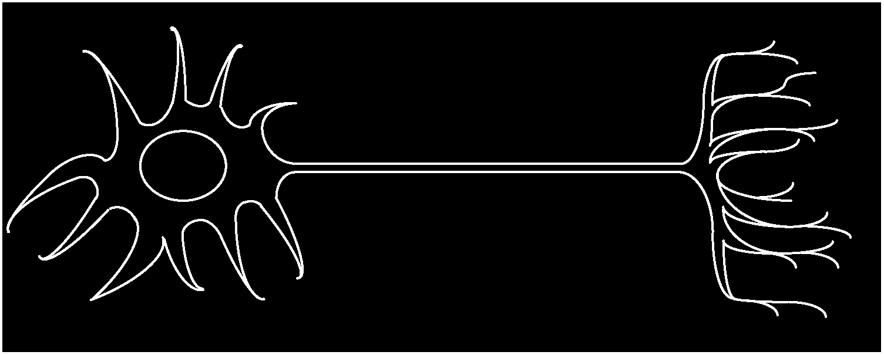
Brain hemodynamic response
neuron
rCBF
O₂
Capillary during
baseline
Capillary during
activation
rCBV
dHg
rCBV: regional Cerebral Blood Volume
rCBF: regional Cerebral Blood Flow
dHg: deoxygenated Hemoglobin
Hg: oxygenated Hemoglobin
Jorge Jovicich
CIMeC, University of Trento, Italy

Slide 10
Blood Oxygenation Level Dependent (BOLD) contrast
BOLD contrast is the net result of two separate effects:
Hemodynamic response
Concentration of oxygenated hemoglobin changes with neural activation
Changes are «local» to brain activation areas
There is a quick decreas in oxy-Hg shortly after activation starts
After a few seconds a local excess of oxy-Hg in active area is observed
Magnetic properties of the hemoglobin molecules
Jorge Jovicich
CIMeC, University of Trento, Italy

Slide 11

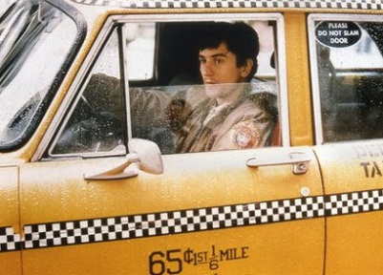
Magnetic properties of hemoglobin (Hb)
Oxygenation states give rise to different magnetic states
Oxygenated-Hb
Isomagnetic with respect to the surrounding tissue, no net magnetization, paired electrons
Deoxygenated-Hb
Paramagnetic with respect to the surrounding tissue, net magnetization, unpaired electrons
Pauling & Coryell, PNAS 1936.
Blood test tube inside an external magnetic field B0
Full taxi
No passengers
Oxygenated Hg
Deoxygenated Hg
Jorge Jovicich
CIMeC, University of Trento, Italy

Slide 12
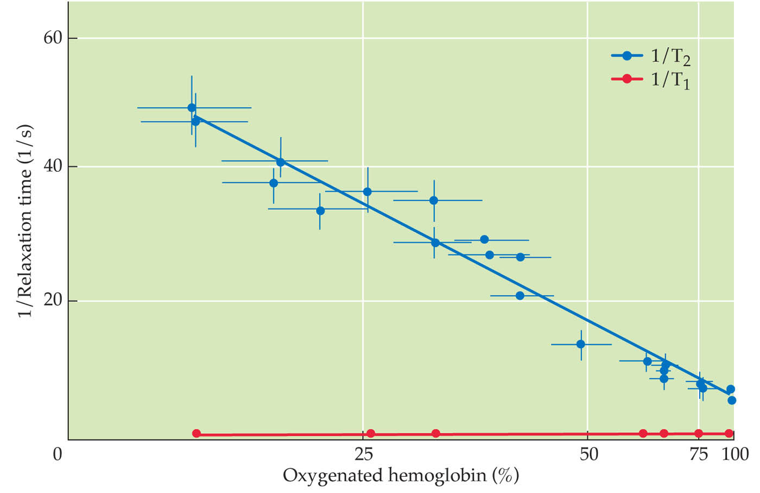
Hemoglobin oxygenation and the MRI signal
De-oxygenation: shorter T₂
Thulborn et al., 1982
T1: no effects
T2: clear effects
Jorge Jovicich
CIMeC, University of Trento, Italy

Slide 13
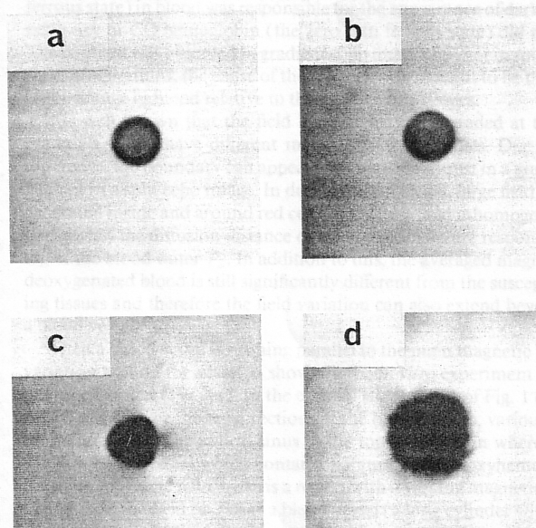
Hemoglobin oxygenation and the MRI signal
Spin Echo
T₂ changes
Gradient Echo
T₂* changes
With fast T2*-weighted
image, we can measure
oxygenation changes
in blood!
Oxyhemoglobin
Maybe we can use
blood oxygenation
changes specific
to brain function?
Little
difference
Large
difference
Deoxyhemoglobin
Test tubes, Ogawa 1990b
Jorge Jovicich
CIMeC, University of Trento, Italy

Slide 14
BOLD sensitivity: T₂* and TE
Signal (t) = M_{xy} (t) = M_{xy0} exp^{-TE/T2*}
S(T_{E}) = S₀ e^{–TE R2*}
Activation (more O₂, less dHg, longer T₂*)
MR signal (M_{xy})
TE
t
Rest (more dHg, shorter T₂*)
Jorge Jovicich
CIMeC, University of Trento, Italy

Slide 15
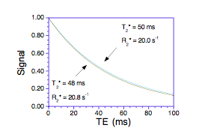
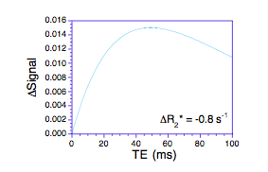
BOLD sensitivity: T₂* and TE
Gray matter T₂* changes
are relatively small
between activation
states.
The difference in T₂*
shows an optimum
TE choice for the
maximum sensitivity
to detect changes of T₂*
Jorge Jovicich
Courtesy of P. Bandettini
CIMeC, University of Trento, Italy

Slide 16
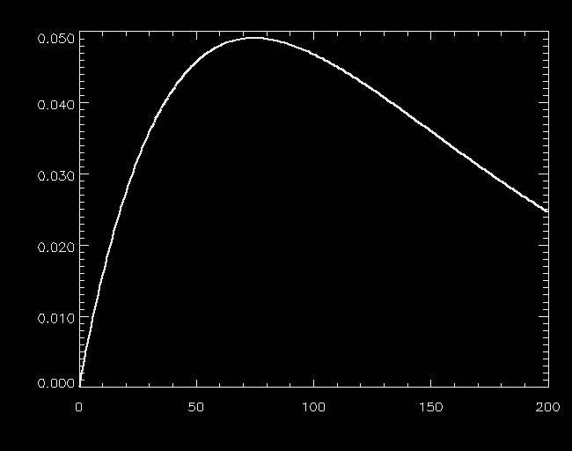
BOLD sensitivity: T₂* and TE
Optimal
range
S(activation) – Signal(rest)
TE_{optimum} ≈ T₂* (active_tissue)
TE (ms)
Jorge Jovicich
CIMeC, University of Trento, Italy

Slide 17
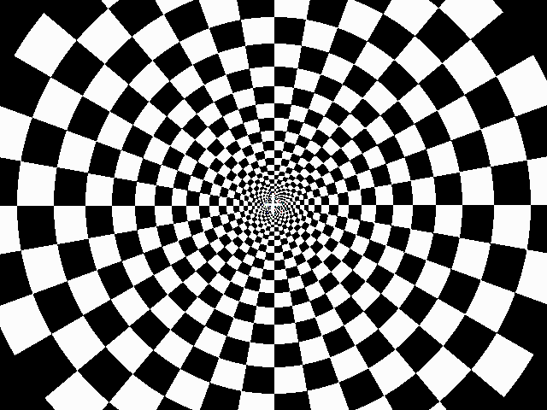
MRI measure of the hemodynamic response
Response to
one brief
stimulus
~12s
Peak
Single-event
design
~5s
Rise
~2s
Baseline
Undershoot
Initial Dip
If [dHb]↑ ⇒ MR signal↓
If [dHb]↓ ⇒ MR signal ↑
Initial Dip
t (seconds after stimulation)
Response to
a series of
brief stimulus
Sustained Response
Block
design
Peak
Rise
Undershoot
Jorge Jovicich
Courtesy of Allen Song
CIMeC, University of Trento, Italy

Slide 18
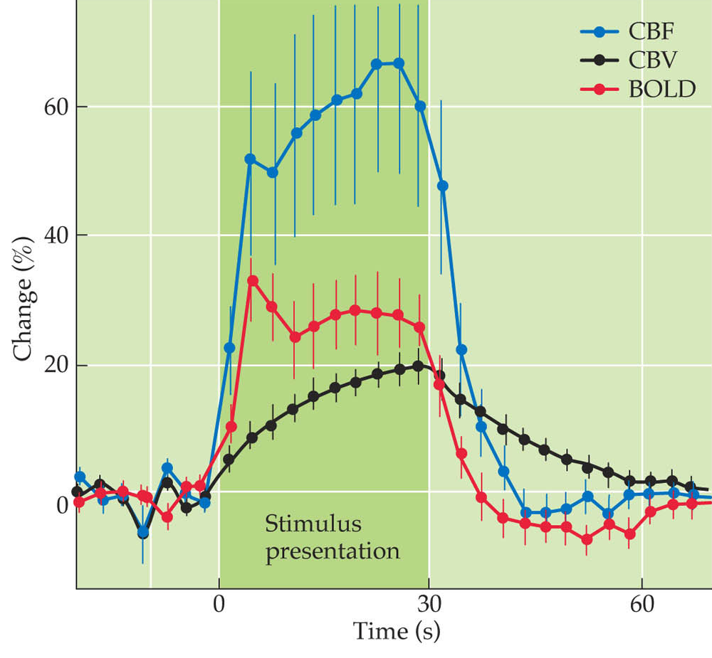
BOLD specificity: suboptimal
Brain activity responses to whisker
stimulation in mice with contrast agent
deoxy-Hb can change because:
Metabolism to support neuronal activation
Blood flow changes
Blood volume changes
BOLD measures the combined effect
CBF: Cerebral Blood Flow
CBV: Cerebral Blood Volume
BOLD: Blood Oxygenation Level Dependent
From Huettel, Song and McCarthy
Jorge Jovicich
CIMeC, University of Trento, Italy

Slide 19
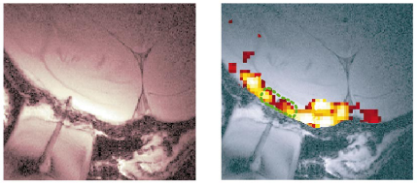
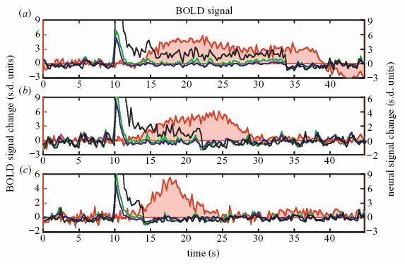
BOLD specificity: there is hope
Evidence that BOLD response reflects pooled local field potential activity (Logothetis 2001)
Jorge Jovicich
CIMeC, University of Trento, Italy

Slide 20
Lecture 4 outline
Brain functional MRI:
We want functional contrast:
Blood Oxygenation Level Dependent (BOLD)
We want to measure signal fluctuations
Fast MRI: Echo Planar Imaging
We want “clean” data for modeling & analysis
Pre-processing
Jorge Jovicich
CIMeC, University of Trento, Italy

Slide 21
What sequence would we like for fMRI?
High Functional sensitivity
T₂* gives the strongest BOLD effects
High Speed
Fast acquisition to follow signal dynamics
High Spatial resolution
To understand anatomical location of activity
High Functional specificity
To correctly interpret signal fluctuations
Jorge Jovicich
CIMeC, University of Trento, Italy

Slide 22
Echo Planar Imaging (EPI)
EPI: standard imaging sequence for fast MRI
(brain fMRI, diffusion, perfusion, etc.)
EPI advantages for brain fMRI
Nowadays easily available
Dominant contrast is T₂* (BOLD)
Spin-echo EPI can have T₂ & T₂*
Typically allows full brain coverage in ∼1sec (or less!)
with 2 mm isotropic voxels (or less!)
EPI limitations:
High sensitivity to local magnetic field inhomogeneities
- Signal loss and image distortions
Gradient switching: Nyquist ghost
Loud
Signal decay during acquisition limits spatial resolution
Jorge Jovicich
CIMeC, University of Trento, Italy

Slide 23
Structural versus EPI MRI
Conventional MRI
(gradient-echo)
TE
RF
t
“slice select”
G_{z}
G_{y}
“freq. enc”
(read-out)
G_{x}
S(t)
k_{y}
k_{x}
one RF excitation,
one line of kspace...
Jorge Jovicich
CIMeC, University of Trento, Italy

Slide 24
What sequence would we like for fMRI?
Conventional MRI
(gradient-echo)
Echo-planar imaging
(gradient-echo)
RF
RF
t
t
“slice select”
G_{z}
G_{z}
G_{y}
G_{y}
“freq. enc”
(read-out)
G_{x}
G_{x}
etc...
S(t)
S(t)
T₂*
t
k_{y}
k_{y}
k_{x}
k_{x}
one RF excitation,
one line of kspace...
one RF excitation,
many lines of k-space...
Jorge Jovicich
CIMeC, University of Trento, Italy

Slide 25
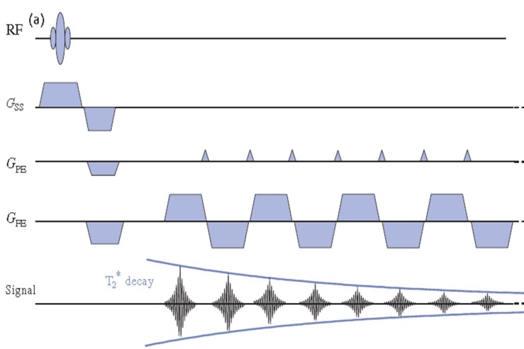
Standard EPI
Gradient-echo EPI (T2*)
Spin-echo EPI (T2 and T2*)
S_{(TE)} = S₀ e^{–TE/T2*}
K-space trayectory
Jorge Jovicich
CIMeC, University of Trento, Italy

Slide 26
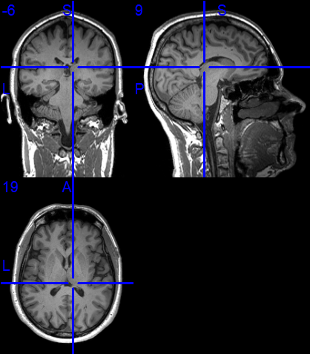
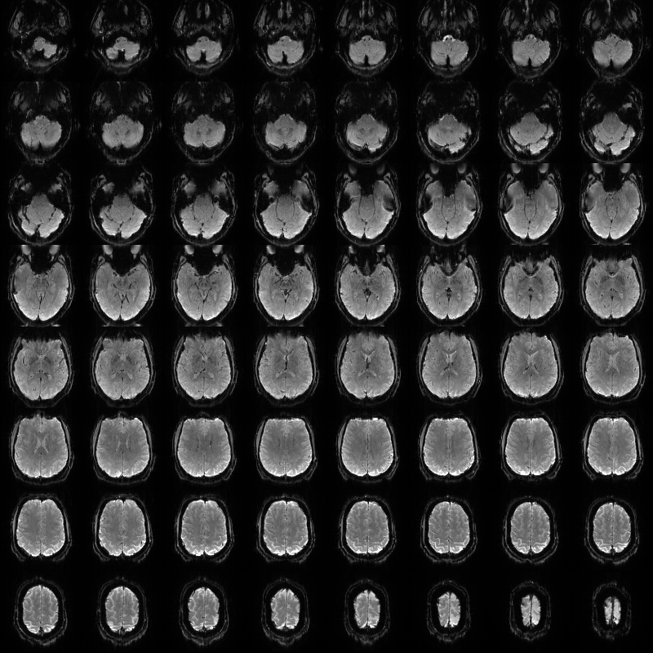
Example
Structural MRI (T1-weighted)
1x1x1 mm³, 328 s
Functional MRI (T2*-weighted)
2x2x2 mm³, 1 s
3T Prisma Siemens, 64 head/neck channel coil
Jorge Jovicich
CIMeC, University of Trento, Italy

Slide 27
Lecture 4 outline
Brain functional MRI:
We want functional contrast:
Blood Oxygenation Level Dependent (BOLD)
We want to measure signal fluctuations
Fast MRI: Echo Planar Imaging
We want “clean” data for modeling & analysis
Pre-processing
Jorge Jovicich
CIMeC, University of Trento, Italy

Slide 28


fMRI MRI pre-processing
Pre-processing: analyses steps to minimize noise, artifacts to get the «cleanest» data for models
Acquisition
fMRI nii
sMRI nii
Head motion correction
dMRI
dicom
Distortion Correction
Slice timing
correction
Sample preparation
Normalization
Quality
check
Temporal smoothing
Spatial smoothing
Signal
model
etc.
Various pre-processing tools available:
https://www.fil.ion.ucl.ac.uk/spm/
https://fsl.fmrib.ox.ac.uk/fsl
https://afni.nimh.nih.gov/
...
This is a generic example
Jury out for optimal details
Jorge Jovicich
CIMeC, University of Trento, Italy

Slide 29
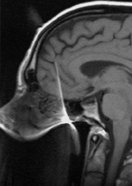
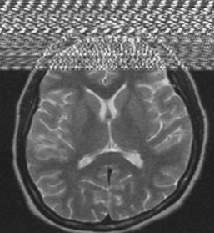
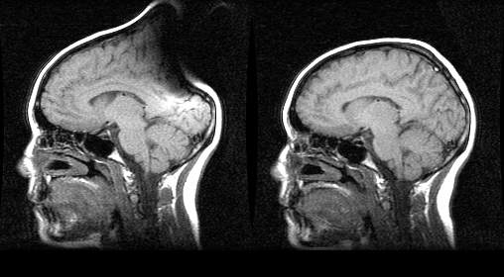
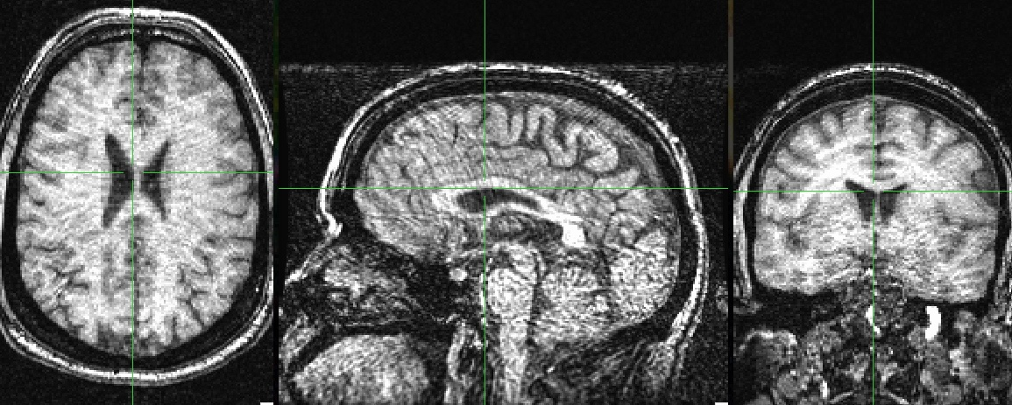
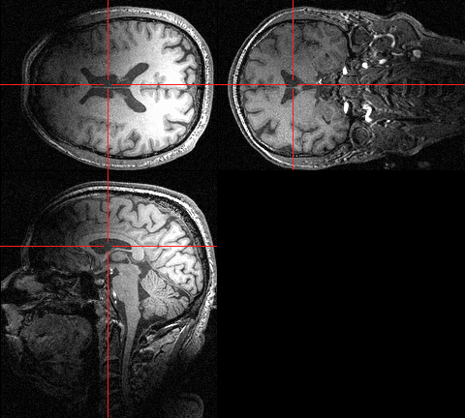
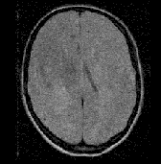
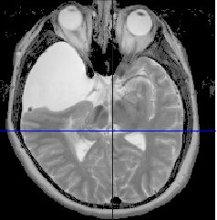
LOOK at the data DURING the experiment
Look for problems, for example:
Severe motion
Dental artifact
RF interference
Metalic hair pin
Wrap around
Severe signal
inhomogeneity
Poor contrast
Lesion
Jorge Jovicich
CIMeC, University of Trento, Italy

Slide 30
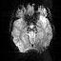
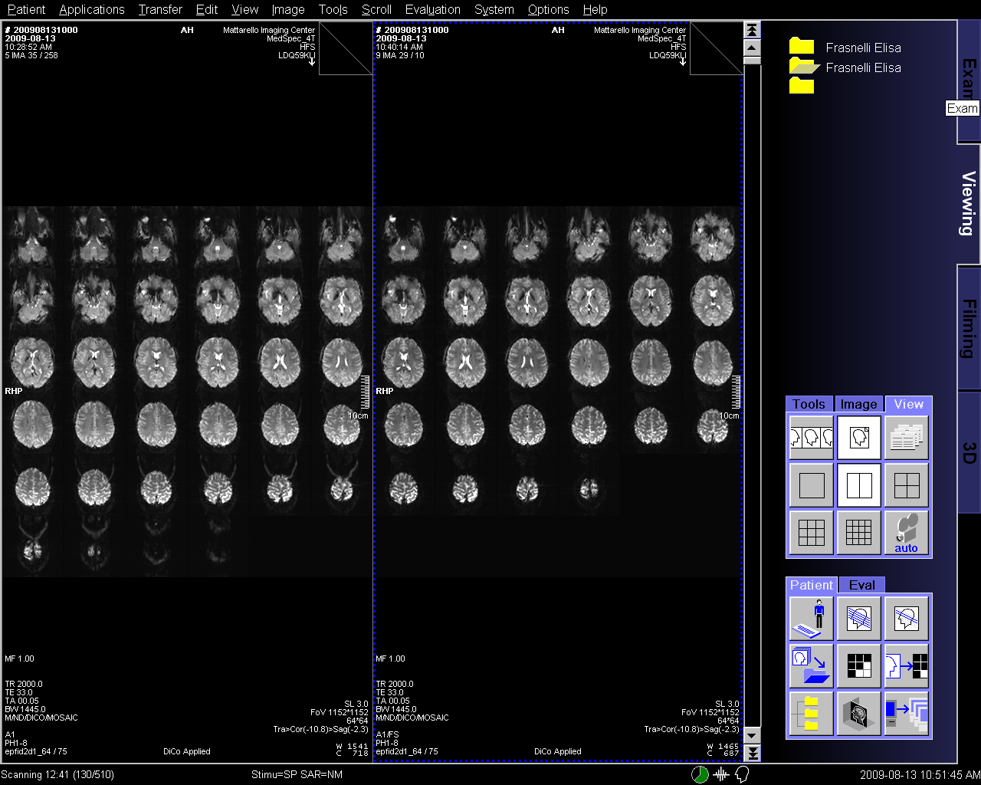
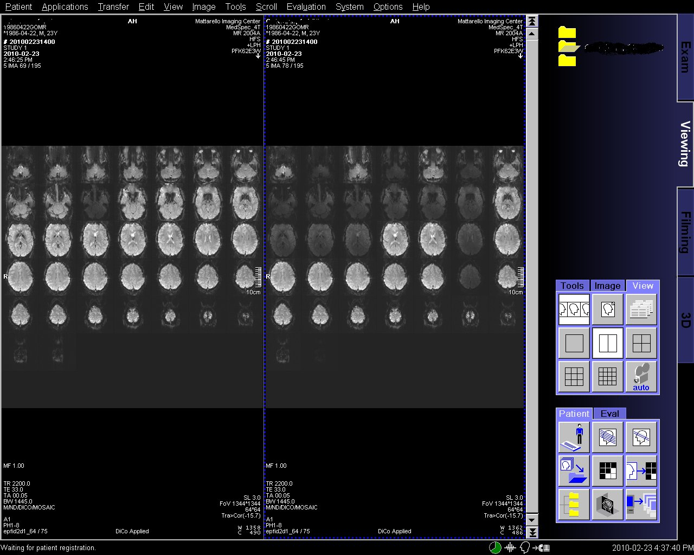
LOOK at the data DURING the experiment
And look for problems, for example:
Signal loss
Fat signal
Distortions
Hardware problems
Jorge Jovicich
Jorge Jovicich
CIMeC, University of Trento, Italy

Slide 31
fMRI MRI pre-processing
Pre-processing: analyses steps to minimize noise, artifacts to get the «cleanest» data for models
Acquisition
fMRI nii
sMRI nii
Head motion correction
dMRI
dicom
Distortion Correction
Slice timing
correction
Sample preparation
Normalization
Quality
check
Temporal smoothing
Spatial smoothing
Signal
model
etc.
Various pre-processing tools available:
https://www.fil.ion.ucl.ac.uk/spm/
https://fsl.fmrib.ox.ac.uk/fsl
https://afni.nimh.nih.gov/
...
This is a generic example
Jury out for optimal details
Jorge Jovicich
CIMeC, University of Trento, Italy

Slide 32
Geometric distortions in EPI
The problem:
Image reconstruction assumes uniform B₀ in the sample
In reality this is not true:
As a result, EPI shows:
areas with signal loss (where T2*<<TE): nothing to do!
areas with geometric distortions: something to do!
Voxel shifts relative to
true voxel location.
So:
If ΔB is measured
we can shift back voxel
Δx, Δy : amounts of shift (misplacement) in x, y directions in mm
FOVx, FOVy : field of view in x, y direction in mm
Δtx, Δty : sampling interval in x, y direction (∝ 1/sampling rate)
Jorge Jovicich
CIMeC, University of Trento, Italy

Slide 33
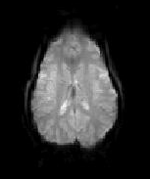
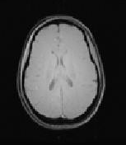
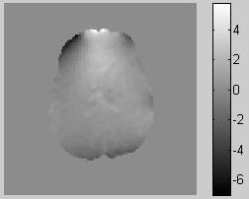
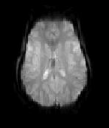
Geometric distortions in EPI
Distorted
EPI
Undistorted
structural
Field
map
Significance
- Misregistration of EPI and Anatomical image
⇒ Incorrect mapping of region of interest(ROI)
⇒ Need to be corrected using Fieldmap
Jorge Jovicich
CIMeC, University of Trento, Italy

Slide 34
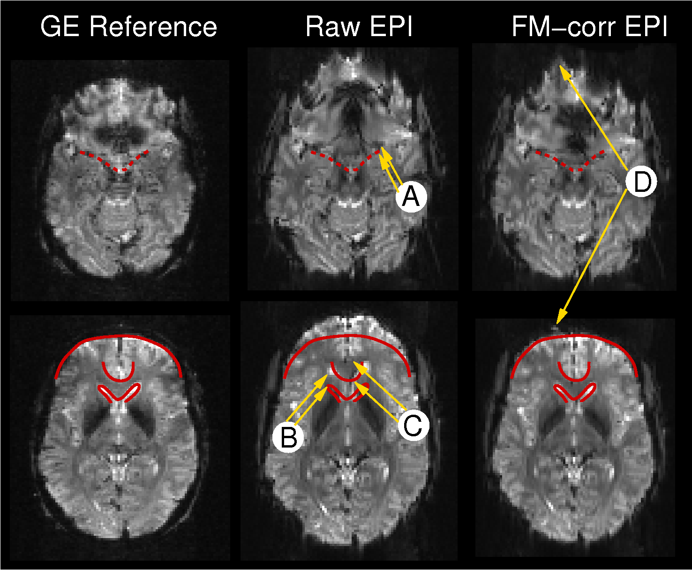
EPI geometric distortions and correction
Ventral/amygdala
Frontal
~ 2 mm distortions close to the amygdala
11 mm distortions at the ventricles
14 mm distortions ant grey matter
Small residual field map errors
Jorge Jovicich
CIMeC, University of Trento, Italy

Slide 35
fMRI MRI pre-processing
Pre-processing: analyses steps to minimize noise, artifacts to get the «cleanest» data for models
Acquisition
fMRI nii
sMRI nii
Head motion correction
dMRI
dicom
Distortion Correction
Slice timing
correction
Sample preparation
Normalization
Quality
check
Temporal smoothing
Spatial smoothing
Signal
model
etc.
Various pre-processing tools available:
https://www.fil.ion.ucl.ac.uk/spm/
https://fsl.fmrib.ox.ac.uk/fsl
https://afni.nimh.nih.gov/
...
This is a generic example
Jury out for optimal details
Jorge Jovicich
CIMeC, University of Trento, Italy

Slide 36
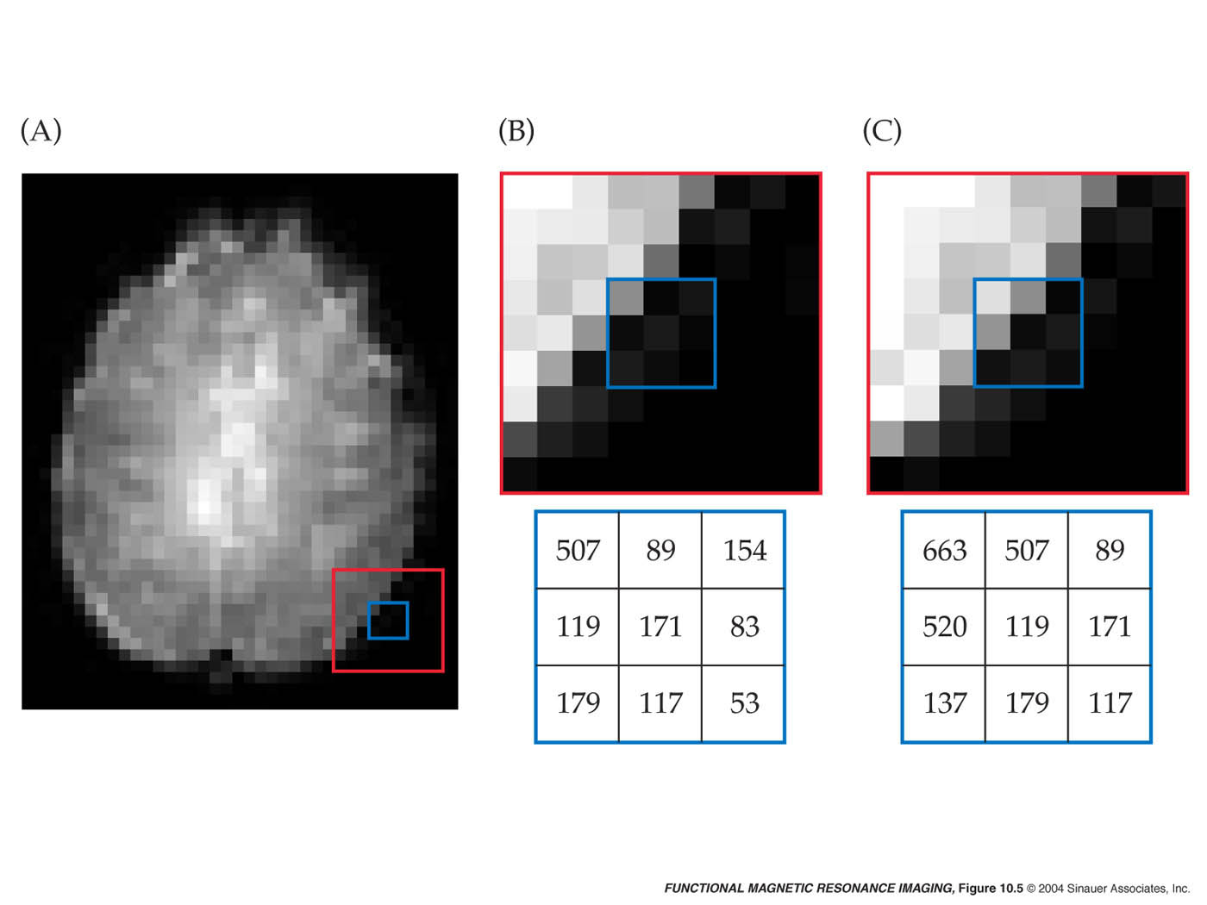
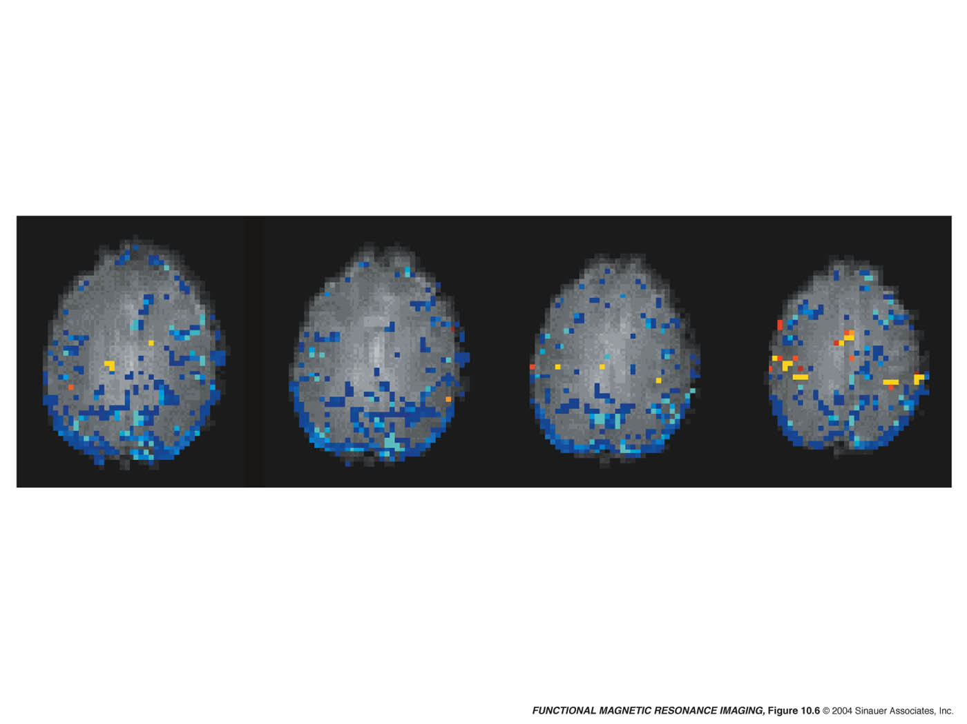
Head motion effects
Motion (even 1 voxel) = Large artificial ‘brain activation’
Modified from Source: Huettel S.A., Song A.W., McCarthy G.
Jorge Jovicich
CIMeC, University of Trento, Italy

Slide 37
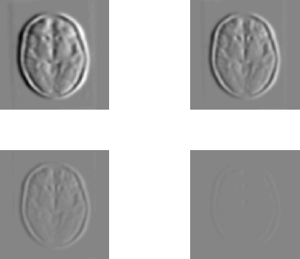
Motion correction: co-registration to reference
Define a reference image from the EPI time series
Iteratively co-register (minimize a cost function) each EPI to reference
Determine the rigid body transformation that minimizes
For each corrected EPI the transformation is defined by
3 translations - in X, Y & Z directions.
3 rotations - about X, Y & Z axes.
Jorge Jovicich
CIMeC, University of Trento, Italy

Slide 38
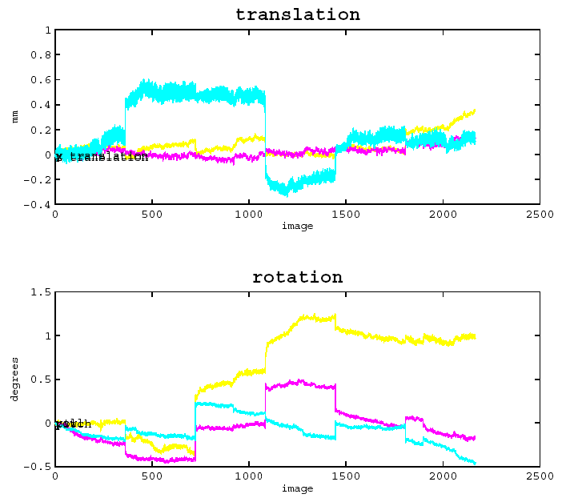
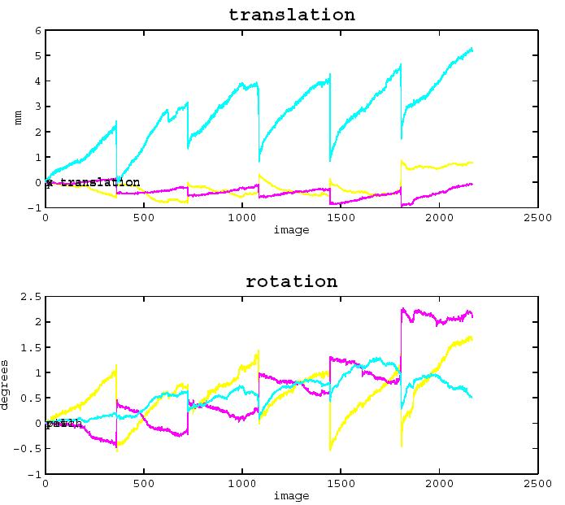
Motion correction results
Could be acceptable motion
Too much motion (>> 1mm)
Modified from Source: Huettel S.A., Song A.W., McCarthy G.
Jorge Jovicich
CIMeC, University of Trento, Italy

Slide 39
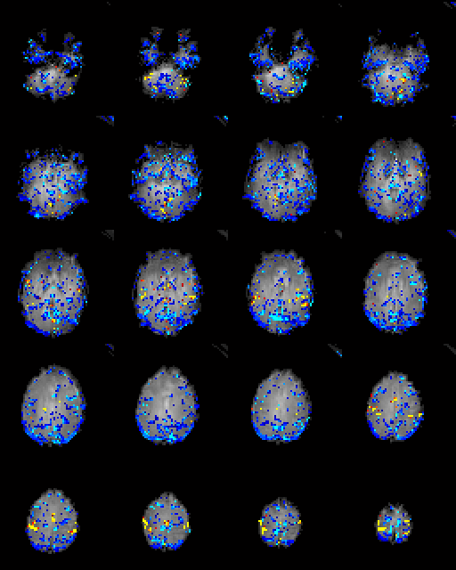
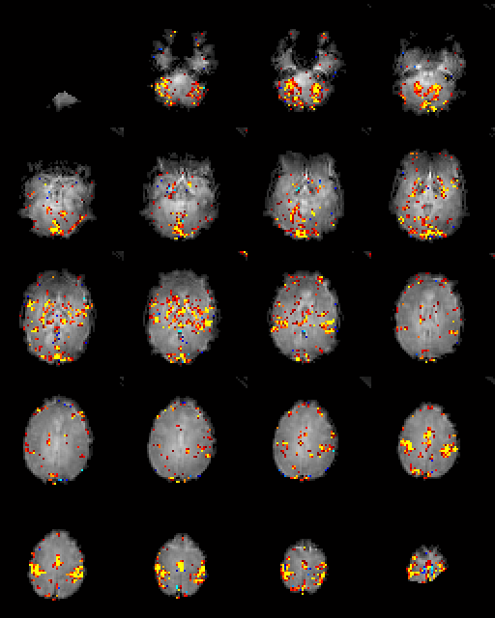
Motor fMRI without/with motion correction
Uncorrected
Corrected
Modified from Source: Huettel S.A., Song A.W., McCarthy G.
Jorge Jovicich
CIMeC, University of Trento, Italy

Slide 40
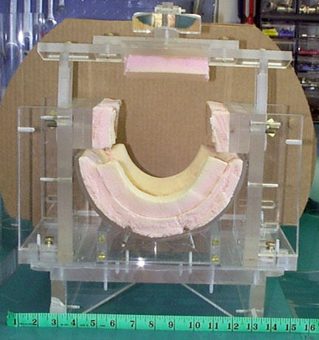
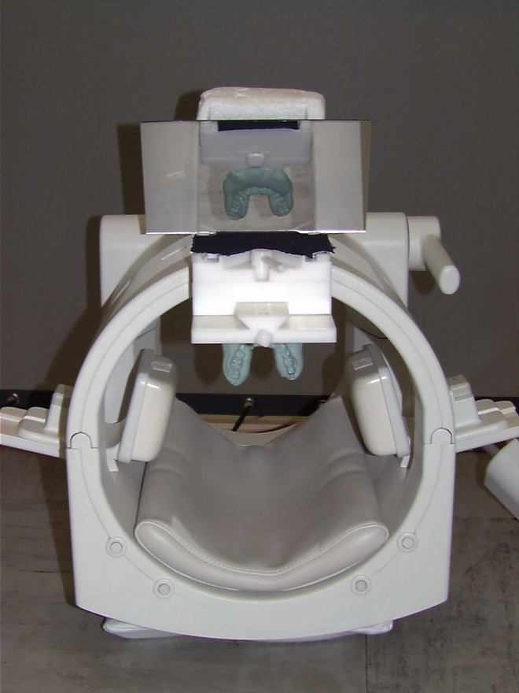
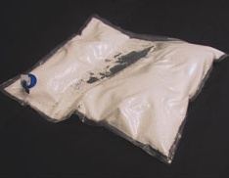
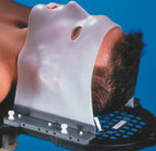

Reducing head motion
Vacuum Pack
Head Vise
(more comfortable than it sounds!)
Bite Bar
Thermoplastic mask
Often collaboration and foam padding works as well as anything
Jorge Jovicich
Source: modified from Jody Culham
CIMeC, University of Trento, Italy
Notes:
40

Slide 41
Reducing motion: Prevention best remedy
Tell your subjects how to be good subjects
“Don’t move” is too vague
Make sure the subject is comfy going in
avoid “princess and the pea” phenomenon
Emphasize importance of not moving at all during beeping
do not change posture
if possible, do not swallow
do not change posture
do not change mouth position
do not tense up at start of scan
Discourage any movements that would displace the head between scans
Do not use compressible head support
Example of info for first-time subjects:
http://defiant.ssc.uwo.ca/Jody_web/Subject_Info/firsttime_subjects.htm
Source: Jody Culham
Jorge Jovicich
CIMeC, University of Trento, Italy

Slide 42
fMRI MRI pre-processing
Pre-processing: analyses steps to minimize noise, artifacts to get the «cleanest» data for models
Acquisition
fMRI nii
sMRI nii
Head motion correction
dMRI
dicom
Distortion Correction
Slice timing
correction
Sample preparation
Normalization
Quality
check
Temporal smoothing
Spatial smoothing
Signal
model
etc.
Various pre-processing tools available:
https://www.fil.ion.ucl.ac.uk/spm/
https://fsl.fmrib.ox.ac.uk/fsl
https://afni.nimh.nih.gov/
...
This is a generic example
Jury out for optimal details
Jorge Jovicich
CIMeC, University of Trento, Italy

Slide 43
Slice acquisition timing correction
The problem:
Ideally
Each brain volume is acquired instantaneously
Each volume time point represents the cognitve
state of the whole brain related to that time point
In reality
Echo image slice is acquired at a different time
Sequential slice acquisition
Interleaved slice acquisition
Consequence:
inacurrate representation of hemodynamic response
Solutions:
Reduce the time for whole-brain sampling
Postprocessing: temporal interpolation
Jorge Jovicich
CIMeC, University of Trento, Italy

Slide 44
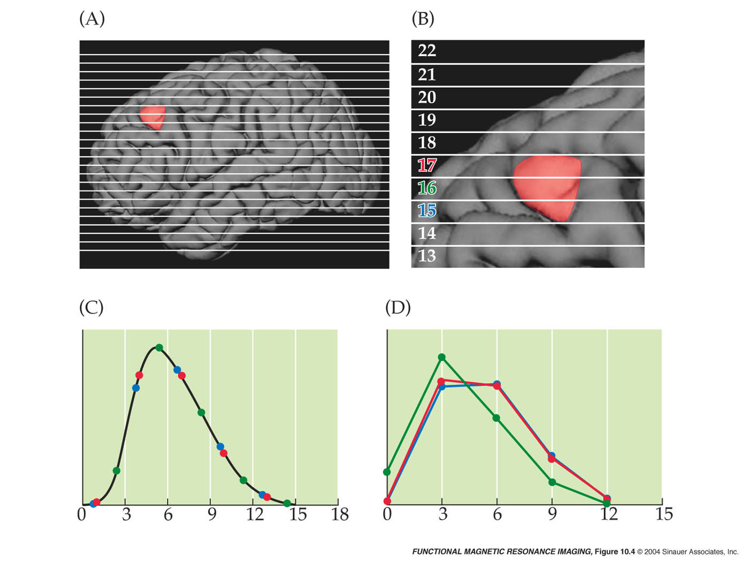
Slice acquisition timing correction
The problem
Interleaved Acquisition
Slice 15, Slice 17, …, Slice 16
Time errors: different
responses for different slices.
Ideal hemodynamic
response for the active
area: same for all slices
Modified from Source: Huettel S.A., Song A.W., McCarthy G.
Jorge Jovicich
CIMeC, University of Trento, Italy

Slide 45
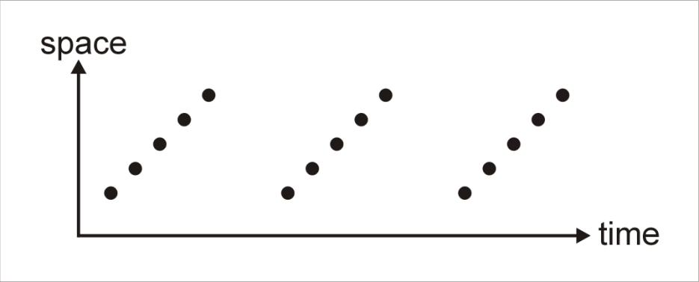
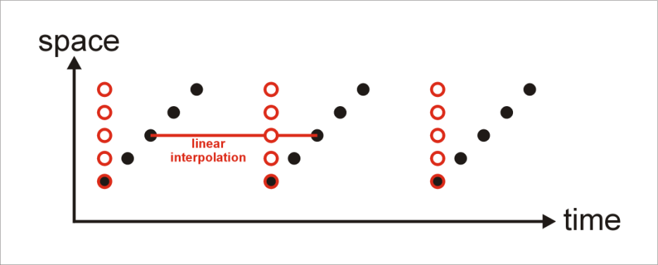
Slice acquisition timing correction
Estimate for each voxel, the signal intensity that would have corresponded to a time shift that aligns all slices to a reference acquisition time.
SEQUENTIAL slice acquisition: functional volume are shifted in time
This is corrected by sinc (or linear) interpolation in time
Jorge Jovicich
CIMeC, University of Trento, Italy

Slide 46
fMRI MRI pre-processing
Pre-processing: analyses steps to minimize noise, artifacts to get the «cleanest» data for models
Acquisition
fMRI nii
sMRI nii
Head motion correction
dMRI
dicom
Distortion Correction
Slice timing
correction
Sample preparation
Normalization
Quality
check
Temporal smoothing
Spatial smoothing
Signal
model
etc.
Various pre-processing tools available:
https://www.fil.ion.ucl.ac.uk/spm/
https://fsl.fmrib.ox.ac.uk/fsl
https://afni.nimh.nih.gov/
...
This is a generic example
Jury out for optimal details
Jorge Jovicich
CIMeC, University of Trento, Italy

Slide 47



Co-registrations and Normalization
Single subject or group analyses:
For each subject:
Co-registration between fMRI and anatomical scans
Rigid body transformation (cost function minimized)
This adds an interpolation step (smoothing)
Co-registration (normalization) of both (now aligned) to standard atlas
For spatial reference
Talairach space, or probabilistic atlases, cortical surface based
This adds an interpolation step (smoothing)
Caveats: normalization space may not represent all subjects
Co-registration
Normalization
EPI
Anatomical
Standard Template
Jorge Jovicich
CIMeC, University of Trento, Italy

Slide 48
Standardized spaces (brain atlas)
Talairach space (proportional grid system)
From atlas of Talairach and Tournoux (1988)
Based on single subject (60y, Female, Cadaver)
Single hemisphere
Related to Brodmann coordinates
Montreal Neurological Institute (MNI) space
Combination of many MRI scans on normal controls
All right-handed subjects
Approximated to Talaraich space
Slightly larger
Taller from AC to top by 5mm; deeper from AC to bottom by 10mm
Used by SPM, National fMRI Database, International Consortium for Brain Mapping
Jorge Jovicich
CIMeC, University of Trento, Italy

Slide 49
fMRI MRI pre-processing
Pre-processing: analyses steps to minimize noise, artifacts to get the «cleanest» data for models
Acquisition
fMRI nii
sMRI nii
Head motion correction
dMRI
dicom
Distortion Correction
Slice timing
correction
Sample preparation
Normalization
Quality
check
Spatial smoothing
Temporal smoothing
Signal
model
etc.
Various pre-processing tools available:
https://www.fil.ion.ucl.ac.uk/spm/
https://fsl.fmrib.ox.ac.uk/fsl
https://afni.nimh.nih.gov/
...
This is a generic example
Jury out for optimal details
Jorge Jovicich
CIMeC, University of Trento, Italy

Slide 50
Temporal filtering fMRI data
Goal: remove fluctuations that may be attributed to sources of no interest
Identify unwanted frequency variation
Drift (low-frequency)
Physiology: cardiac (1-1.5 Hz), respiratory (0.2-0.3 Hz)
Task overlap (high-frequency)
Reduce power around those frequencies through application of filters
Potential problem: removal of frequencies composing response of interest
Jorge Jovicich
Jorge Jovicich,
CIMeC, University of Trento, Italy

Slide 51


Temporal filtering fMRI data
Signal drifts from
hardware instabilities
Drift on an activation
time course
Huettel, Song & McCarthy, 2004,
Functional Magnetic Resonance Imaging
Source: Smith chapter in Functional MRI:
An Introduction to Methods
Jorge Jovicich
CIMeC, University of Trento, Italy
Notes:
51

Slide 52


Temporal filtering fMRI data
Signal fluctuations due to respiration
http://www.fil.ion.ucl.ac.uk/spm/course/
Respiration
Every 4-10 sec (0.3 Hz)
Moving chest distorts susceptibility
Cardiac Cycle
Every ~1 sec (0.9 Hz)
Pulsing motion, blood changes
Solutions
Gating
Filter AND avoiding paradigms at those frequencies
Source: Jody Culham
You want your paradigm frequency to be in a “sweet spot” away from the noise
Jorge Jovicich
CIMeC, University of Trento, Italy
Notes:
52

Slide 53
fMRI MRI pre-processing
Pre-processing: analyses steps to minimize noise, artifacts to get the «cleanest» data for models
Acquisition
fMRI nii
sMRI nii
Head motion correction
dMRI
dicom
Distortion Correction
Slice timing
correction
Sample preparation
Normalization
Quality
check
Temporal smoothing
Spatial smoothing
Signal
model
etc.
Various pre-processing tools available:
https://www.fil.ion.ucl.ac.uk/spm/
https://fsl.fmrib.ox.ac.uk/fsl
https://afni.nimh.nih.gov/
...
This is a generic example
Jury out for optimal details
Jorge Jovicich
CIMeC, University of Trento, Italy

Slide 54


Spatial smoothing
Spatial smoothing essentially ‘blurs’ your functional data.
Why would you ever want to reduce the spatial resolution of your data?
Spatial smoothing may often be required when averaging data across several subjects due to the individual variations in brain anatomy and functional organization.
Increased degrees of smoothing (FWHM)
Gaussian smoothing kernel
Jorge Jovicich
CIMeC, University of Trento, Italy

Slide 55












Spatial smoothing: reducing false positives
Unsmoothed Data
Smoothed Data (kernel width 5 voxels)
Modified from Source: Huettel S.A., Song A.W., McCarthy G.
Jorge Jovicich
CIMeC, University of Trento, Italy

Slide 56


Spatial smoothing: reducing false positives
Modified from Source: Huettel S.A., Song A.W., McCarthy G.
Jorge Jovicich
CIMeC, University of Trento, Italy

Slide 57
Spatial smoothing
Advantages
Increases Signal to Noise Ratio (SNR)
Matched Filter Theorem: Maximum increase in SNR by filter with same shape/size as signal
Reduces number of comparisons
Allows application of Gaussian Field Theory
May improve comparisons across subjects
Signal may be spread widely across cortex, due to intersubject variability
Disadvantages
Reduces spatial resolution
Challenging to smooth accurately if size/shape of signal is not known
Notes:
Often used in general linear model analysis
Often not used in layer fMRI
Jorge Jovicich

Slide 58
fMRI MRI pre-processing
Pre-processing: analyses steps to minimize noise, artifacts to get the «cleanest» data for models
Acquisition
fMRI nii
sMRI nii
Head motion correction
dMRI
dicom
Distortion Correction
Slice timing
correction
Sample preparation
Normalization
Quality
check
Temporal smoothing
Spatial smoothing
Signal
model
etc.
Various pre-processing tools available:
https://www.fil.ion.ucl.ac.uk/spm/
https://fsl.fmrib.ox.ac.uk/fsl
https://afni.nimh.nih.gov/
...
This is a generic example
Jury out for optimal details
Jorge Jovicich
CIMeC, University of Trento, Italy

Slide 59
Literature recommendations include
.
Collection of overview papers from various leaders in the field
20 years of fMRI
Reproducibility in Neuroimaging
MRI of cortical layers
Cleaning up fMRI time series
Web materials:
https://practicalfmri.blogspot.com/
http://www.fmri4newbies.com/
OHBM Educacional Series: https://www.pathlms.com/ohbm/courses/ (tons of stuff!)
ISMRM Educational Series: https://www.ismrm.org/education/
https://www.ismrm.org/online-education-program/diffusion-perfusion-fmri-videos/
https://gate.nmr.mgh.harvard.edu/wiki/whynhow/
Jorge Jovicich
CIMeC, University of Trento, Italy

Slide 60


Concept map for lectures
Lecture 1
MR Image & Contrast
NMR Signal origin
MR Safety
Spatial encoding
Magnetic gradients
Pulse sequences
Powerful magnet
Radio frequency
Magnetic field gradients
Powerful magnet
Radio frequency
Magnetic field gradients
Lecture 2
Lecture 4
Structural MRI
Lecture 3
Functional MRI
Diffusion MRI
Contrast, important parameters
Sequences & artifacts
Analyses & applications
Contrast, important parameters
Sequences & artifacts
Pre-processing
Contrast, important parameters
Sequences & artifacts
Analyses & applications
Jorge Jovicich
CIMeC, University of Trento, Italy

Slide 61

















Acknowledgements
http://r.unitn.it/en/cimec/mri
Moira
Marizzoni
Giovanni
Frisoni
Silvio
Sarubbo
Collaborators
include
Olivier
Collignon
Valeria d.
Maggiore
Flor
Jacobacci
D. Zacà
C. Maffei
V. Iacovella
N. Pace
Current /recent lab include
L. Novello
F. Saviola
M. Akinci
S. Tambalo

Slide 62
Tonight (http://www.milonga.be)
TANGO BAR
21:30 - 02:00
Rue de Dublin 13, 1050 Ixelles, Belgium MILONGA BRUSSELS

